Slide 1

"Exploring Genetic Programming"
An Introduction to Evolutionary Algorithms in Computing
Qusai Al-Awawdeh 10th January / 2024

Slide 2

Outline
Introduction to Genetic Programming
Overview of Evolutionary Algorithms
Key Components of Genetic Programming
How Genetic Programming Works
Applications of Genetic Programming
Challenges and Limitations
Success Stories
Q&A

Slide 3

Introduction
Genetic Programming (GP) stands as an evolutionary algorithm rooted in the principles of natural selection. It autonomously evolves and adapts populations of computer programs, represented as hierarchical structures, to optimize their performance in solving complex problems. GP holds significance in computational domains, providing a dynamic approach for automated program synthesis, machine learning, and optimization, where traditional methods may fall short.

Slide 4
Evolutionary Algorithms Overview
Evolutionary Algorithms (EAs) form a family of optimization algorithms inspired by the process of natural selection. Genetic Programming (GP) is a subset of EAs. The iterative process involves:
Initialization: Generating an initial population of candidate solutions.
Evaluation: Assessing the fitness of each solution based on predefined criteria.
Selection: Choosing solutions for reproduction based on their fitness.
Crossover: Combining genetic material from selected solutions to create new ones.
Mutation: Introducing random changes to maintain diversity.
Iteration: Repeating the process over multiple generations.
In Genetic Programming, this approach is tailored to evolve computer programs represented as trees. Now, let's explore the core components of Genetic Programming.

Slide 5

Key Components of Genetic Programming
Genetic Representation: Programs are represented as tree structures, where nodes denote functions and terminals represent input variables or constants.
Fitness Function: Evaluates the performance of each program in the population, guiding the evolutionary process toward optimal solutions.
Selection: Determines which programs will contribute to the next generation based on their fitness, simulating natural selection.
Crossover: Involves the exchange of genetic material between parent programs, creating new programs with characteristics from both.
Mutation: Introduces random changes to individual programs, fostering diversity and exploration in the solution space.

Slide 6
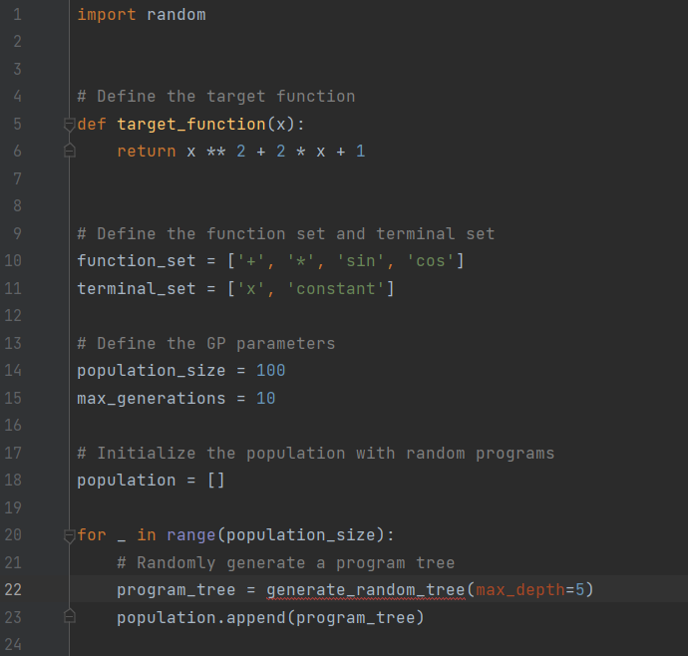
How Genetic Programming Works – An Example
Initialization:
Generate an initial population of random programs represented as trees.

Slide 7
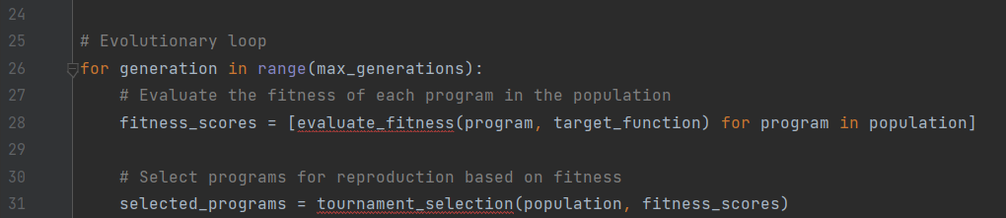
How Genetic Programming Works – An Example
2. Evaluation:
Assess the fitness of each program based on a predefined fitness function.
Programs are ranked according to their effectiveness in solving the problem.
3. Selection:
Choose programs for reproduction based on their fitness.
Higher fitness increases the likelihood of being selected.

Slide 8
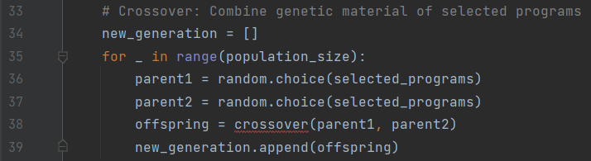
How Genetic Programming Works – An Example
4. Crossover:
Combine genetic material of selected programs to create new offspring programs.
Mimics the exchange of genetic material in biological reproduction.

Slide 9
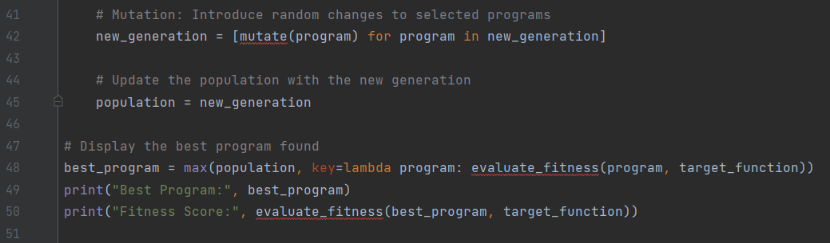
How Genetic Programming Works – An Example
5. Mutation:
Introduce random changes to selected programs to maintain diversity.
Enhances exploration of the solution space.
6. Iteration:
Repeat the process for multiple generations.
Over time, the population evolves, and programs become more adapted to the problem at hand.

Slide 10
Applications of Genetic Programming
Symbolic Regression: Discovering mathematical expressions that fit data
Automated Program Synthesis: Generating computer programs
Game AI: Evolving strategies for games
Circuit Design: Evolving electronic circuit designs

Slide 11
Challenges and Limitations
Overfitting: Programs might perform well on training data but poorly on new data
Computational Complexity: Evolutionary algorithms can be computationally intensive
Lack of Understanding: Evolved programs may be complex and hard to interpret

Slide 12
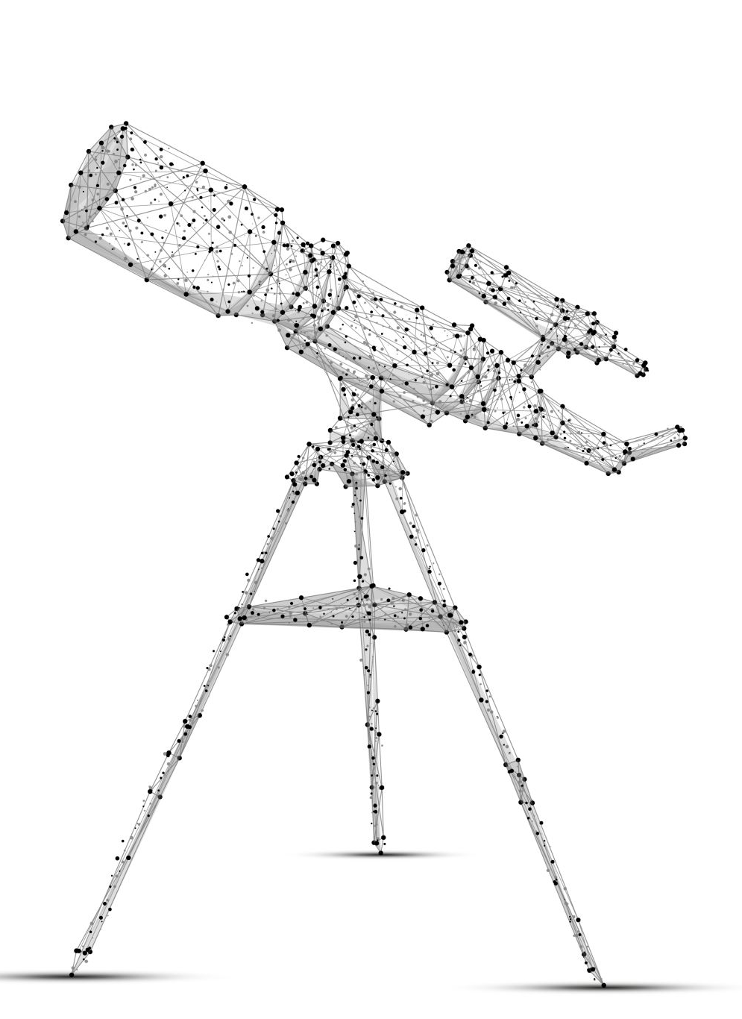
Success Stories
Evolving Antenna Designs at NASA
NASA's Jet Propulsion Laboratory (JPL) used Genetic Programming to evolve antenna designs. The evolved antennas demonstrated improved performance characteristics, showcasing the potential for GP in optimizing complex engineering designs.
https://ipnpr.jpl.nasa.gov/progress_report/42-234/42-234A.pdf

Slide 13
References
Koza, J. R. (1992). Genetic Programming: On the Programming of Computers by Means of Natural Selection. MIT Press.
Poli, R., Langdon, W. B., & McPhee, N. F. (2008). A Field Guide to Genetic Programming. Lulu.com.
Luke, S. (2013). Essentials of Metaheuristics (2nd ed.). Lulu.com.

